Slide 1
Boston Covid-19
New Cases Forecasting
Group 3
Felix Castaneda Guzman
Trieu Vo
Karishma Abhijit Bhalshankar

Slide 2
Introduction
COVID-19 has caused major disease and even death in normally healthy young and middle-aged people.
Because of the fast spread of COVID-19, it is critical to offer precise predictions of how sensitive geographic areas are to the spread of this virus.
Our goal is to predict new Covid-19 cases 15 days into the future using multiple predictors from 15 days ago.
There are several questions that we want to find answers to:
How can we predict future Covid-19 cases in the next 15 days using the past information?
What is the necessary information to predict new Covid-19 cases efficiently?
Our method is using different Machine Learning models such as VAR, SARIMA, ARIMA and XGBoost to predict new cases and visualize them clearly to show the difference between our prediction and reality.

Slide 3
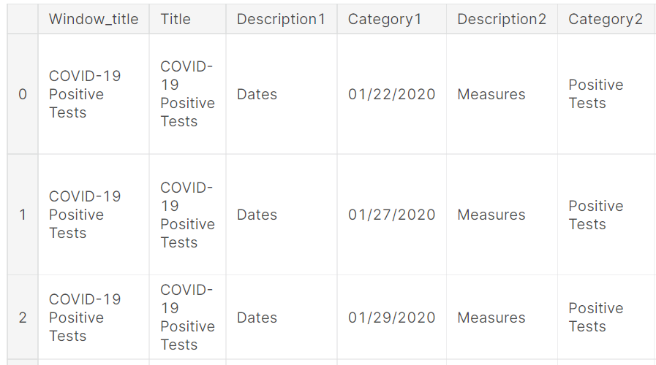
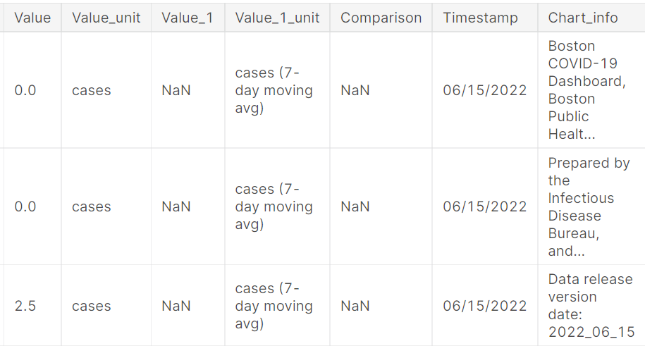
Dataset
Boston Covid-19 dataset collected by the Boston Public Health Commission.
Source: https://bphc-dashboard.shinyapps.io/BPHC-dashboard/
17,727 observations of Covid19 metrics over the past three years, from 2020-01-01 to 2022-06-14, equivalent to 856 days.
13 features

Slide 4
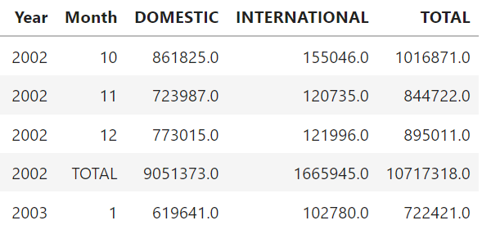
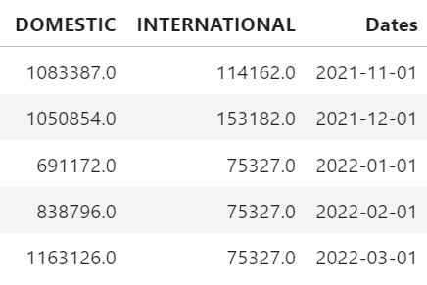
Dataset
Logan International Airport dataset collected by the Bureau of Transportation Statistics (BTS) Passengers All Carriers - Boston, MA.
Source: https://www.transtats.bts.gov/Data_Elements.aspx?Data=1/
259 observations of passenger’s arrival at the Logan Airport from 2002 to 2022.
5 features

Slide 5
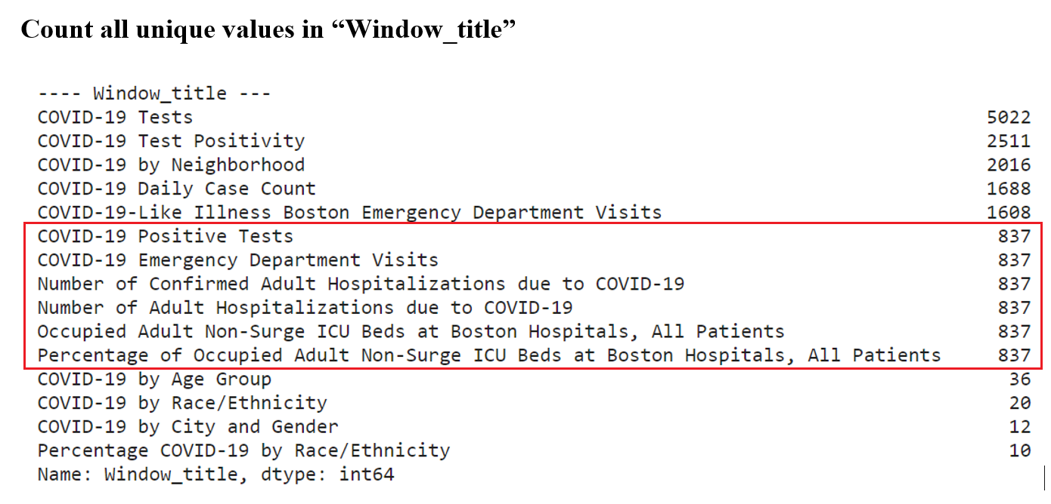
Methods

Slide 6
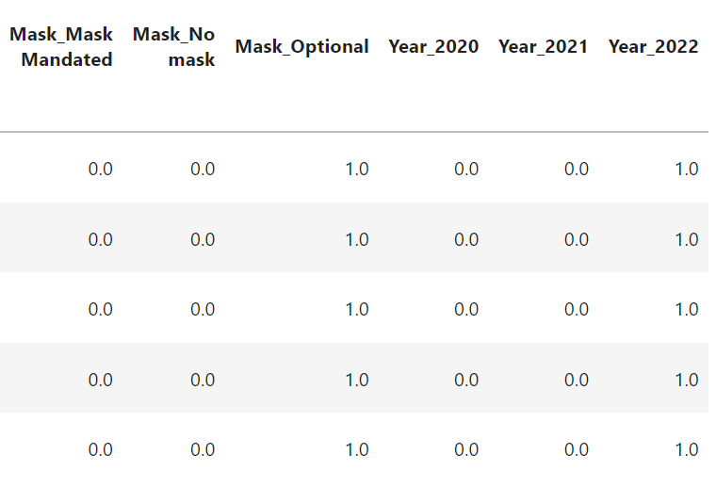
Methods: Pre-Processing
Create new dataframes for “COVID-19 Tests”, “All-Boston COVID-19 Tests”, “Community COVID-19 Tests”, “College COVID-19 Tests“, “COVID-19 Emergency Department Visits”,…
Merge all subset dataframes
Fill missing values
Sort dataset by dates
Create new variables “Year”, “Mask” (“No mask”, “Mask mandated” and “Optional”)
Convert categorical variables to dummy variables (“Year”, “Mask”)
Remove unnecessary categorical variables
Create correlation matrix
Create descriptive statistics tables for all samples, by Year and by Mask Policy.

Slide 7
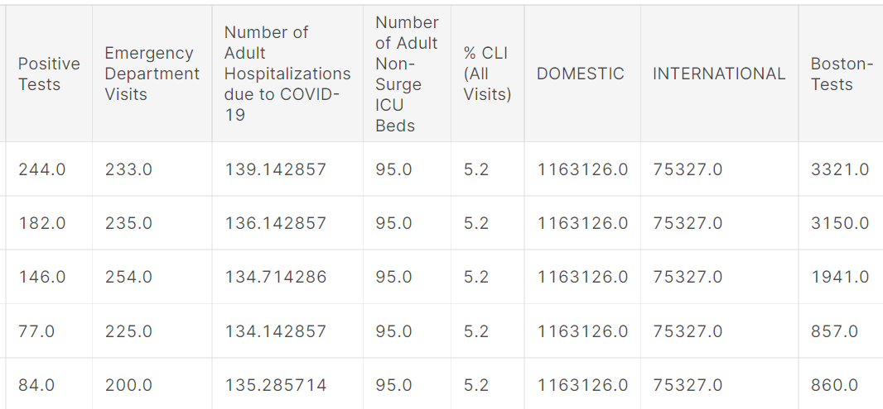
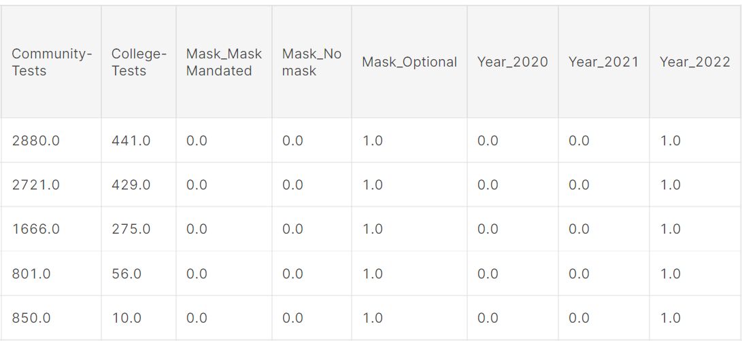
Final Dataframe

Slide 8
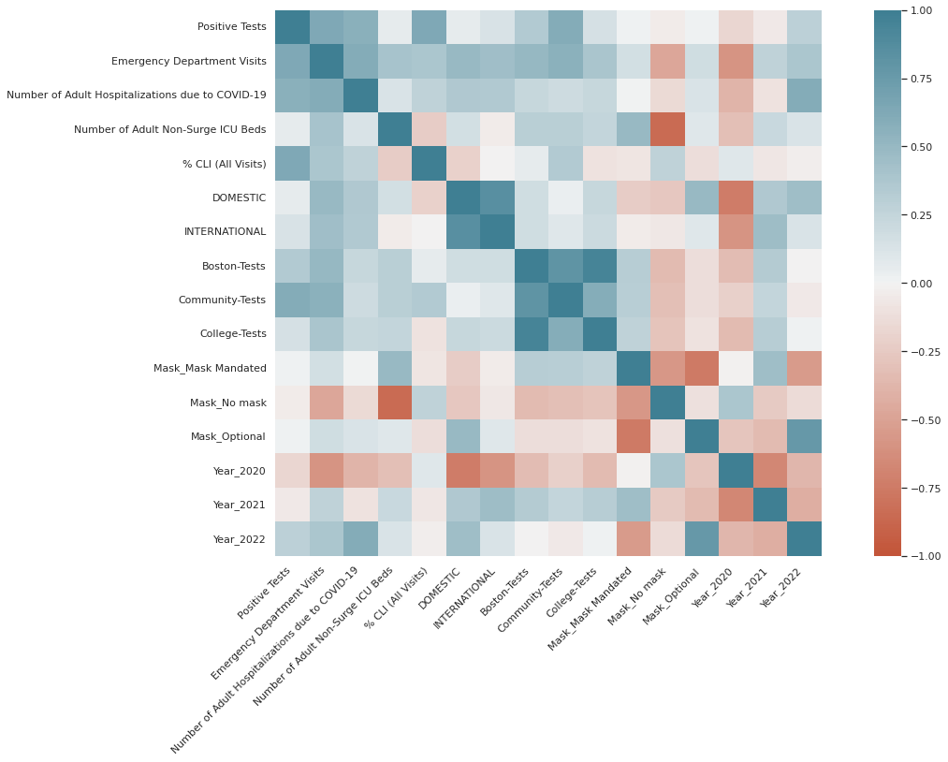
Correlation
Year 2022 has higher correlation with the target variable Positive Cases
Number of Covid19 Tests in the community of Boston has also more correlation with the target
In order to tune the model we can only pick community-Test feature to predict Positive Cases in Boston area.

Slide 9
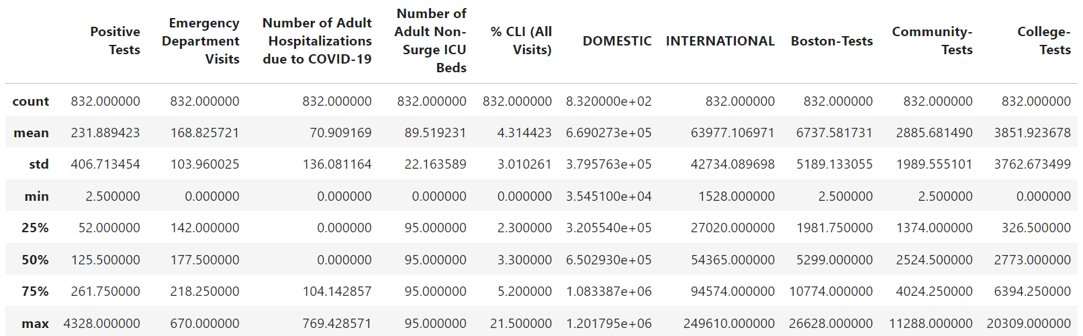
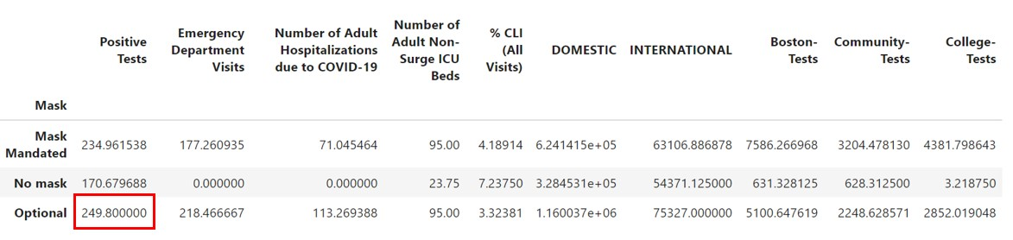
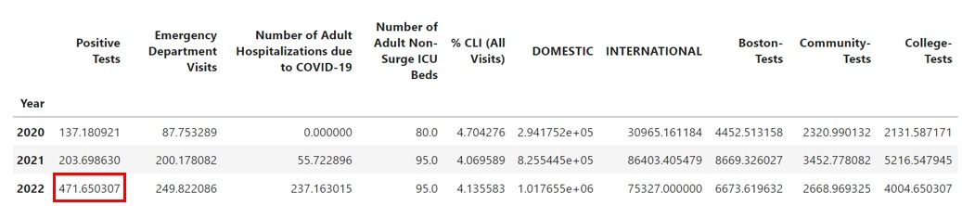
Statistics tables
Descriptive statistics tables
For all sample
Group by Mask Policy
Group By Year

Slide 10
Methods
XGBoost Model
Why XGBoost?
Most popular model used in Kaggle
Predict New Positive Cases In Boston
Evaluate predictions using MAE, MSE, RMSE, R^2
Visualize the Feature Importance to predict Positive Cases
Model Setup:
Split the training set and the test set with ratio 8:2
Parameters: n_estimators = 100, learning_rate = 0.08, gamma = 0, subsample = 0.75, colsample_bytree = 1, max_depth = 10

Slide 11
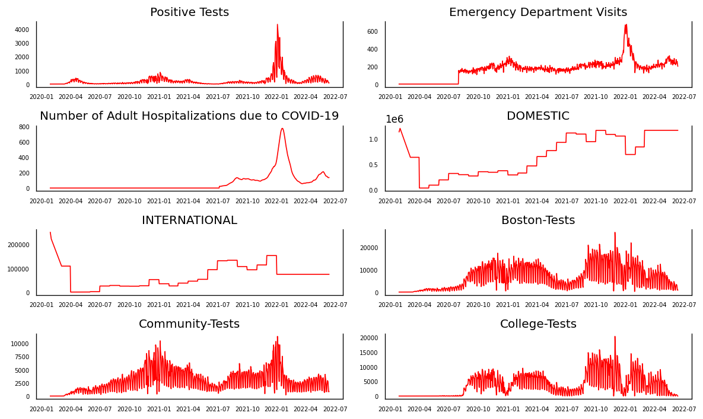
Visualization

Slide 12
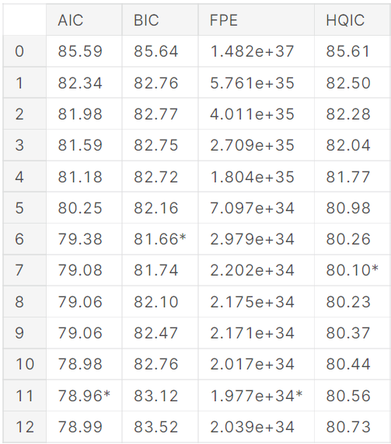
Methods
VAR model
Why VAR?
VAR model is used when two or more time series influence each other.
Predict and Forecasting
Check Causality of all possible combinations of the Time series
(P values) Null Hypothesis
Check Cointegration. (statistically significant relationship.)
Positive Cases - EDV - # Adult Hosp -Domestic Arrival Passenger
Building:
Select the Order (P) (Number of Lags) of VAR model. (AIC)
Predicting and Forecasting (15 Days) In the sample and out of Sample
Evaluate:
MAPE, ME, MAE, MPE, RMSE, CORR, MINMAX

Slide 13
Methods
ARIMA model
Why ARIMA?
ARIMA uses past values to predict future ones. Moving-Average (MA) terms
It is use to Predict and Forecasting Time Series
Build the ARIMA model:
Parameters
p =lagging (past values)
d = differencing (non-stationary to stationary)
q = noise (shock events)
d=0 since our Time Series is stationary, p=10 from previous AIC tests and, q = 1
Predict 15 days in the sample data and forecast 15 out of the sample data

Slide 14
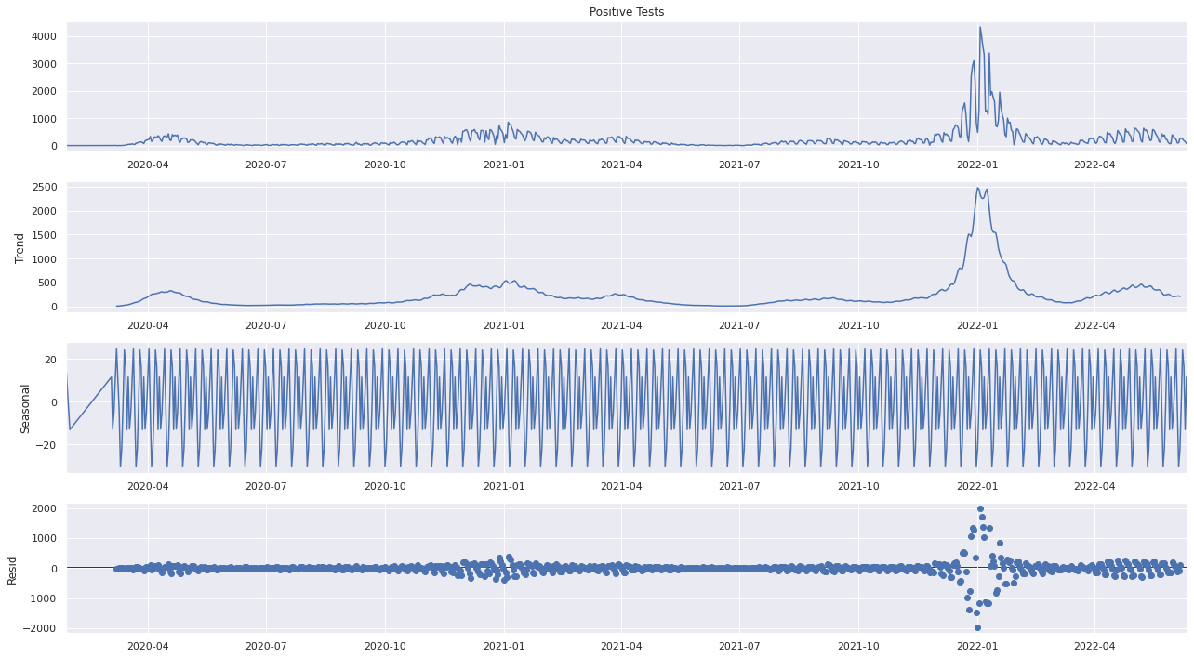
Methods
SARIMA model
Why Sarima?
Seasonality component to the time series.
Build the SARIMA model:
Decompose the time-series into three distinct components: trend, seasonality, and noise
P = Seasonality
D = Trend,
Q = Noise
Use AIC (Akaike Information Criterion) to evaluate the quality of model
Predict and Forecast 15 days

Slide 15
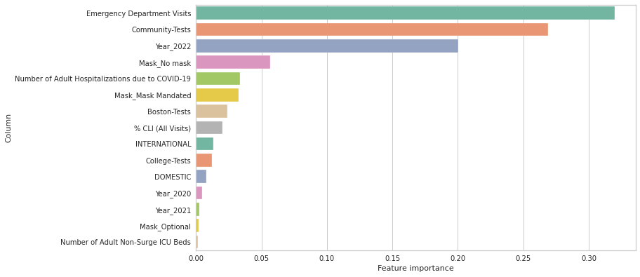
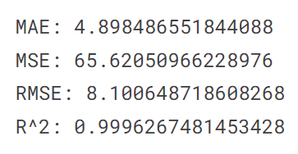
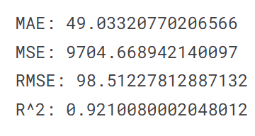
Results and Interpretation
XGBoost model
It predicts very well on the training set (R^2 = 99%) and pretty well on the test set (R^2 = 92%)
Emergency Department Visits, Community Tests, Year_2022 and No Mask are the key features that most influenced the prediction of positive tests. They fit the current situation in Boston.

Slide 16
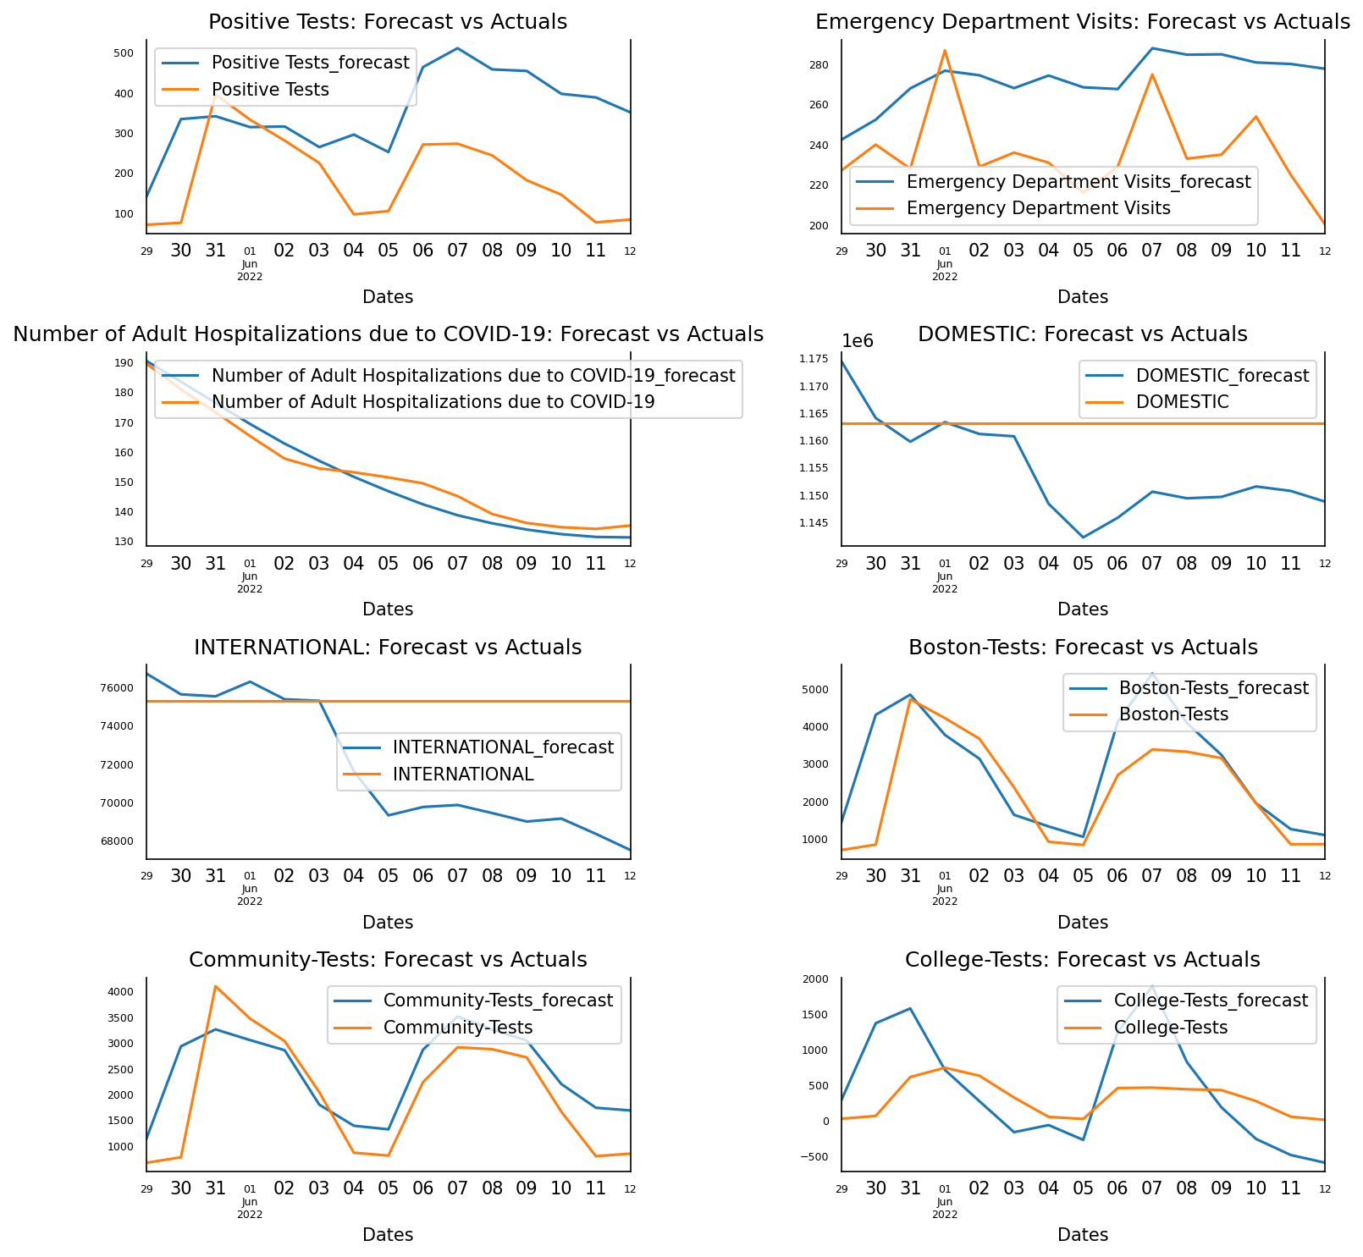
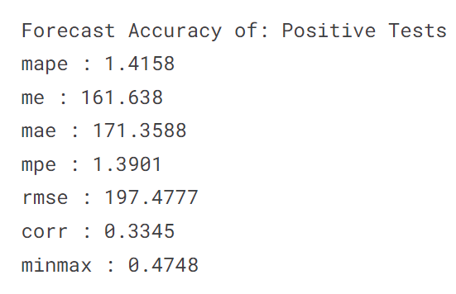
Results and Interpretation
VAR model
Predict well on:
Positive Tests
It predicts pretty well although the prediction line does not really match the actual line
Number of Adult Hospitalizations due to COVID-19
Boston-Tests
Community-Tests

Slide 17
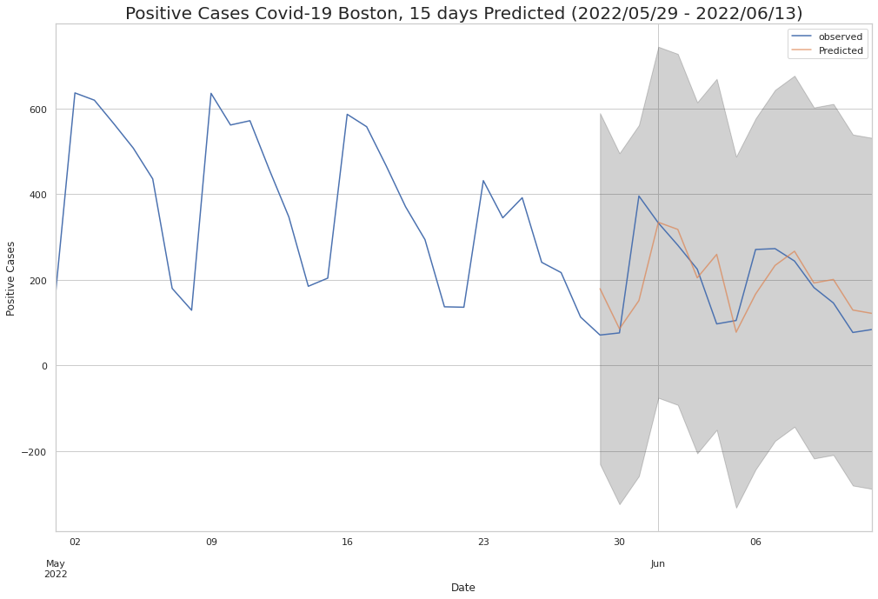
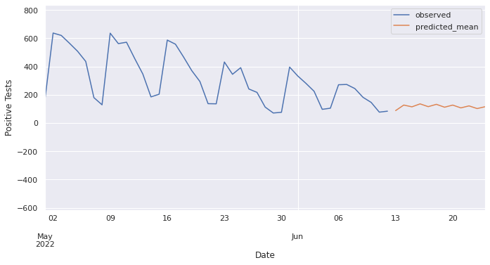
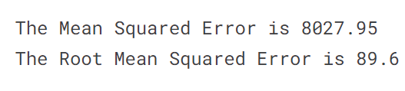
Results and Interpretation
SARIMA model
Predict new cases on the test set in 15 days into the future (from 2022/5/29 to 2022/6/13)
It predicts pretty well although the prediction line does not really match the actual line
Predict new cases in 15 days after 2022/6/13
The prediction line fluctuates and stays below 200 cases, consistent with the current situation in Boston

Slide 18
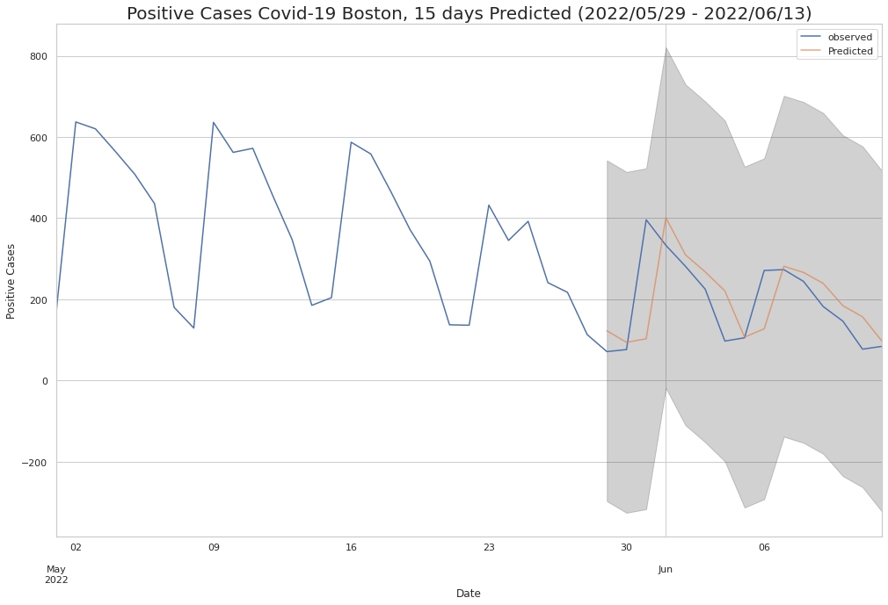
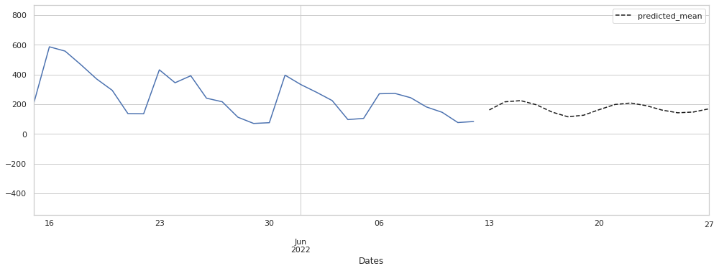

Results and Interpretation
ARIMA model
Predict new cases on the test set in 15 days into the future (from 2022/5/29 to 2022/6/13)
It predicts very well. The actual line closely resembles the prediction line
Predict new cases in 15 days after 2022/6/13
The prediction line fluctuates and stays below 200 cases, consistent with the current situation in Boston

Slide 19
Conclusion
In this final project, we use the Boston Covid-19 dataset collected by the Boston Public Health Commission and the Logan International Airport dataset collected by the Bureau of Transportation Statistics.
We go through different data science steps to preprocess the data, such as Data Collection, Data Cleaning, Data Manipulation, Data Visualization, and Data Reduction.
We build 4 models to predict the new Covid-19 cases 15 days into the future. They are VAR, SARIMA, ARIMA, and XGBoost models. ARIMA model predicts very well. The actual line resembles the prediction line. The outcomes of SARIMA and VAR models are acceptable. The XGBoost model also gives a high R^2 score on the test set (92%).
We use Feature Importance to find out how features affect the new Covid-19 cases. Emergency Department Visits, Community Tests, Year_2022, and No Mask are the key features that most influenced the prediction of positive tests. They are consistent with the current situation in Boston.

Slide 20
Thank you for listening!
For any questions we can stay in touch with emails given below:
bhalshankar.ka@northeastern.edu
vo.trieu@northeastern.edu
castaneda.f@northeastern.edu

Slide 21
References:
Selva Prabhakaran July 7, 2019 Vector Autoregression (VAR) – Comprehensive Guide with Examples in Python https://www.machinelearningplus.com/time-series/vector-autoregression-examples-python/
Selva Prabhakaran August 22, 2021 ARIMA Model – Complete Guide to Time Series Forecasting in Python https://www.machinelearningplus.com/time-series/arima-model-time-series-forecasting-python/
Raphael Bubolz Larrosa Jul 15, 2019 How to forecast sales with Python using SARIMA model
https://towardsdatascience.com/how-to-forecast-sales-with-python-using-sarima-model-ba600992fa7d

